Slide 1



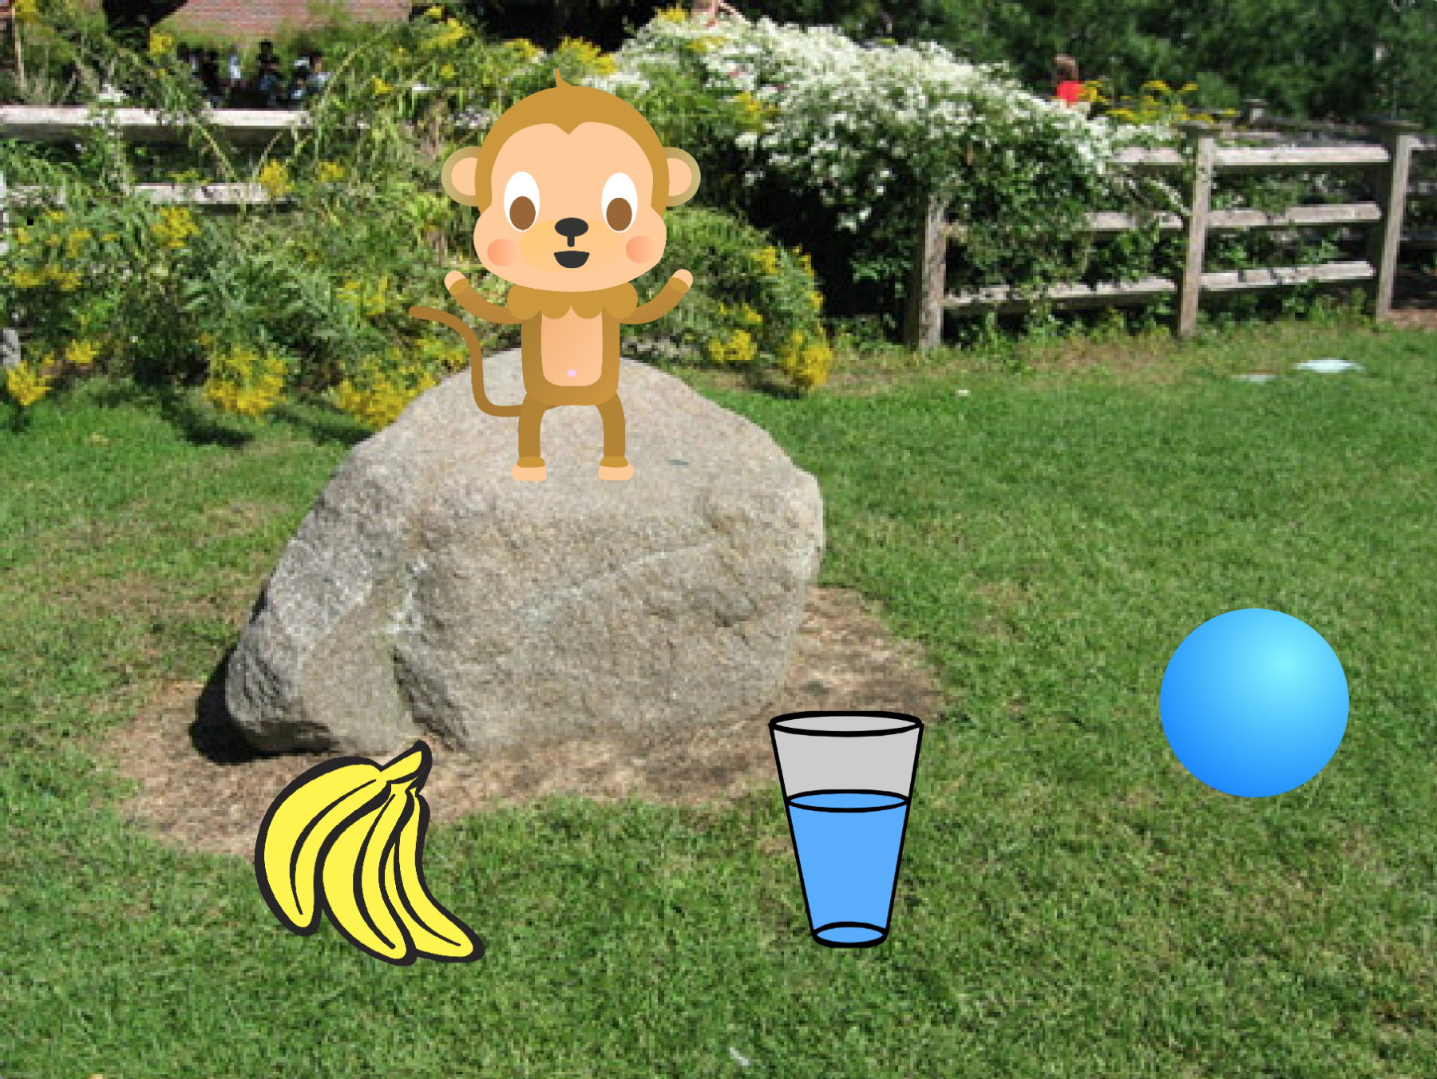
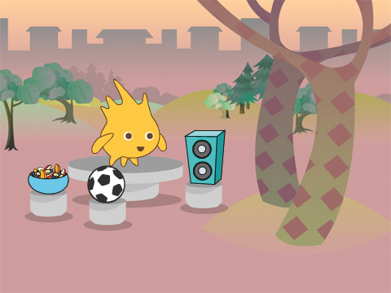


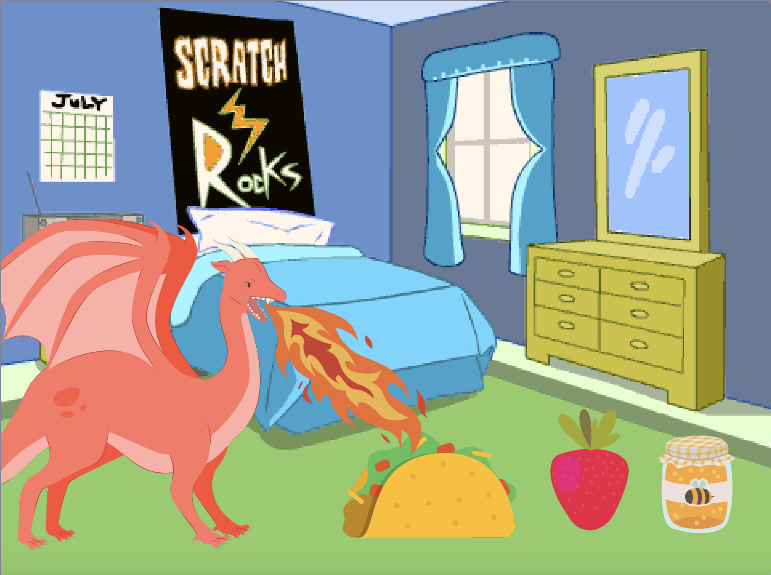
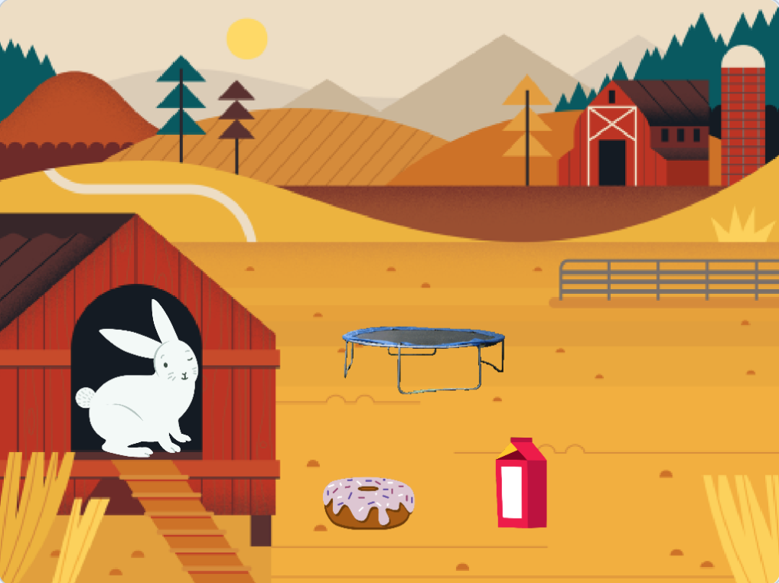


Virtual Pet Cards
Create an interactive pet that can eat, drink, and play.
scratch.mit.edu
Set of 7 cards

Slide 2
Virtual Pet Cards
Use these cards in this order:
Introduce Your Pet
Animate Your Pet
Feed Your Pet
Give Your Pet a Drink
What Will Your Pet Say?
Time to Play
How Hungry?
scratch.mit.edu
Set of 7 cards

Slide 3

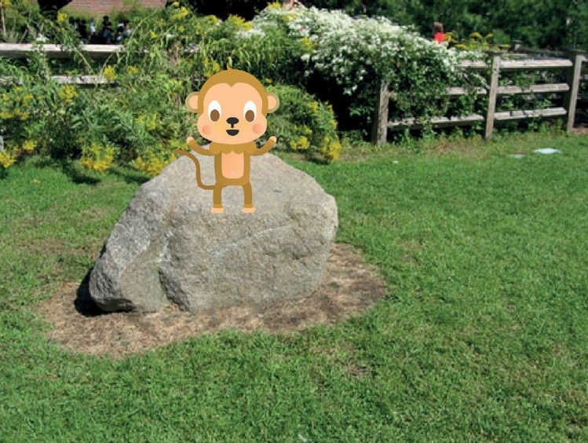
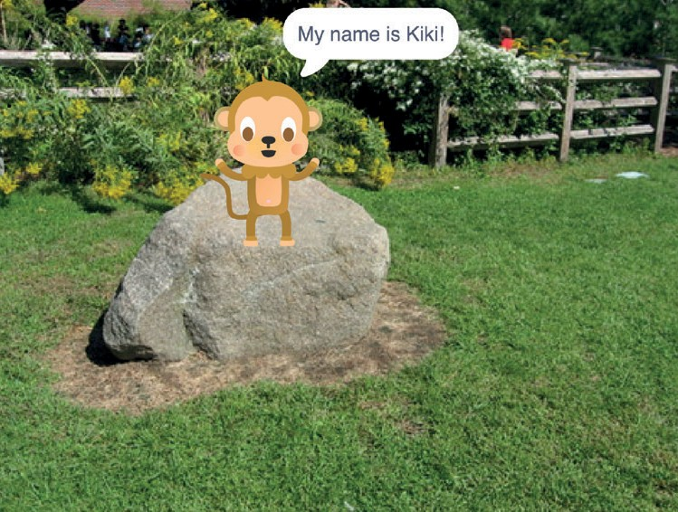

Introduce Your Pet
Choose a pet and have it say hello.
Virtual Pet
1

Slide 4



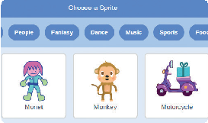
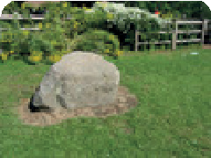

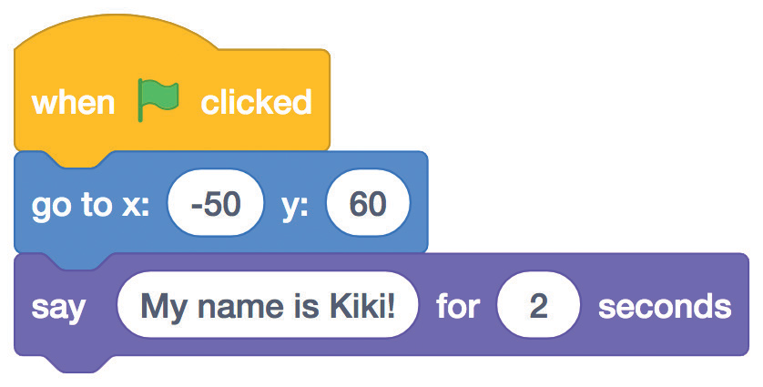


Introduce Your Pet
scratch.mit.edu
GET READY
Pick a sprite with more than one costume.
Choose a backdrop, like Garden Rock.
Choose a sprite to be your pet, like Monkey.
Scroll over sprites in the Sprite Library to see their different costumes.
Garden
Monkey
ADD THIS CODE
Drag your pet to where you want it on the Stage.
Set its position. (Your numbers may be different.)
Monkey
Type what you want your pet to say.
TRY IT
Click the green flag to start.

Slide 5

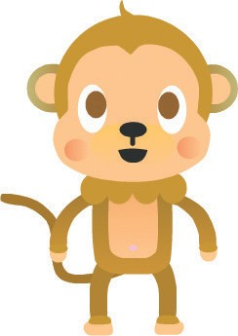

Animate Your Pet
Bring your pet to life.
Virtual Pet
2

Slide 6

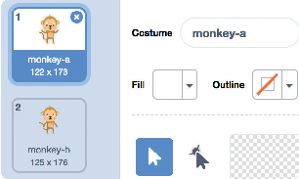

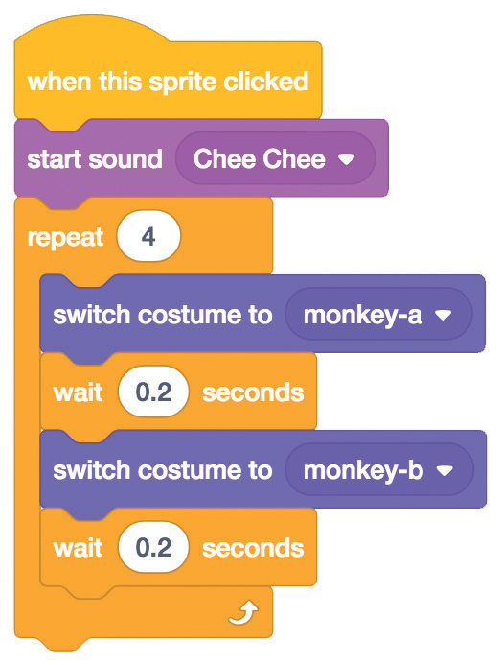

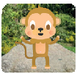
Animate Your Pet
scratch.mit.edu
GET READY
Click the Costumes tab to see your pet’s costumes.
ADD THIS CODE
Click the Code tab and add this code.
Monkey
Choose a costume.
Choose a different costume.
TRY IT
Click your pet.

Slide 7
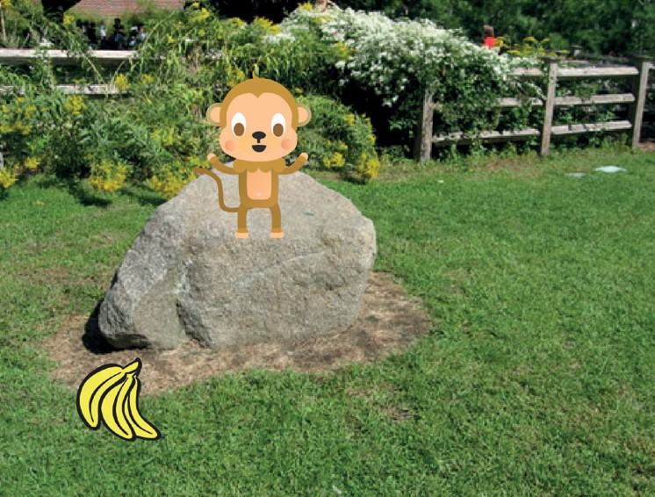
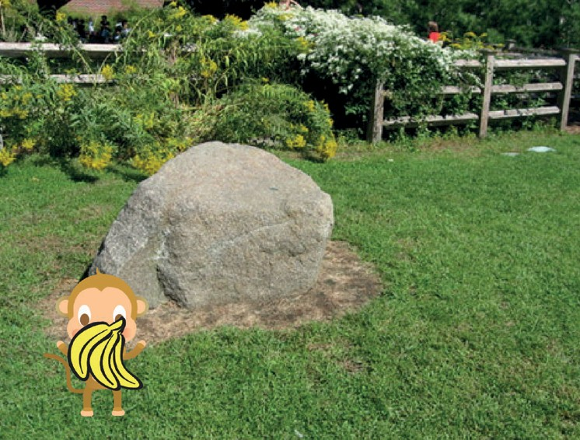
Feed Your Pet
Click the food to feed your pet.
Virtual Pet
3

Slide 8





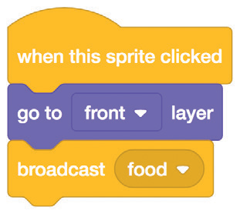

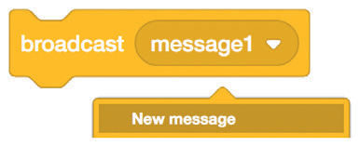
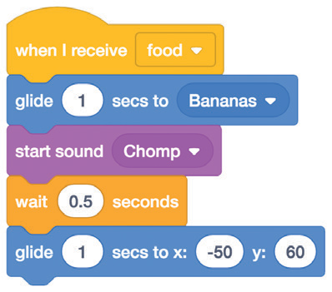

Feed Your Pet
scratch.mit.edu
GET READY
Click the Sounds tab.
Monkey
Choose a food sprite, like Bananas.
Bananas
Choose a sound from the Sounds Library, like Chomp.
ADD THIS CODE
Click the code tab.
Bananas
Select New message
and name it food.
Broadcast the food message.
Select your pet.
Choose food from the menu.
Choose Bananas from the menu.
Monkey
Glide to the starting position.
TRY IT
Click the food.

Slide 9
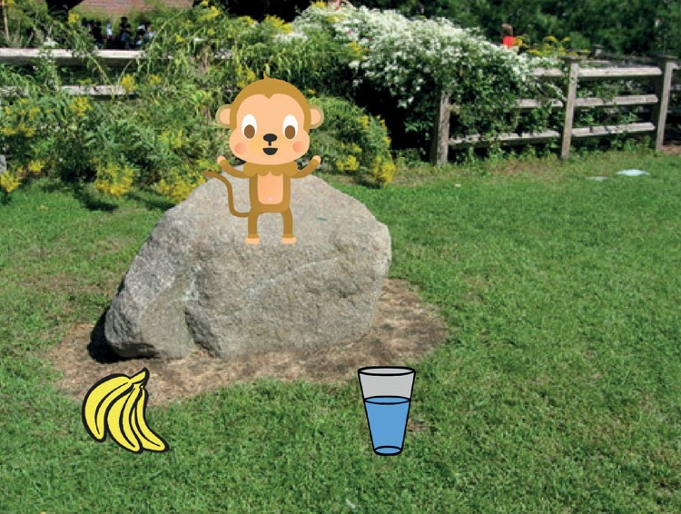
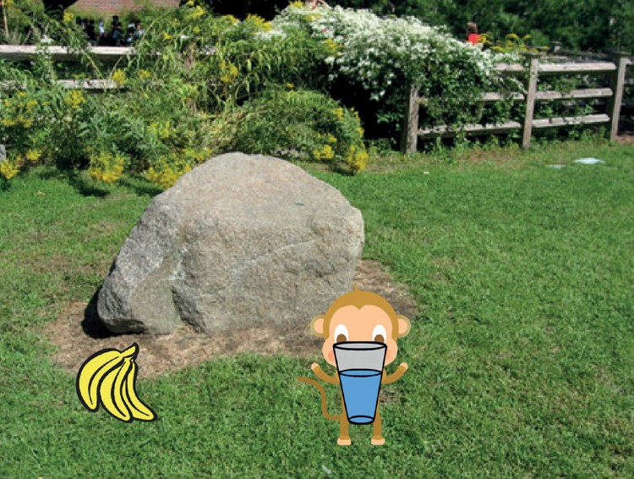
Give Your Pet a Drink
Give your pet some water to drink.
Virtual Pet
4

Slide 10

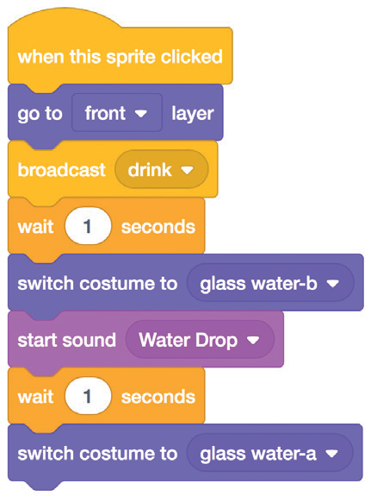

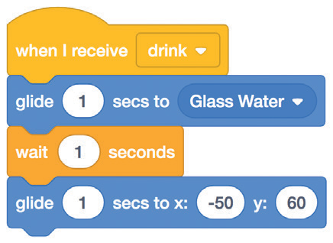
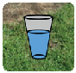
Give Your Pet a Drink
scratch.mit.edu
GET READY
Choose a drink sprite, like Glass.
Glass Water
ADD THIS CODE
Glass Water
Broadcast a new message.
Switch to the empty glass.
Switch to the full glass.
Tell your pet what to do when it receives the message.
Choose drink from the menu.
Choose Glass Water from the menu.
Monkey
Glide to the starting position.
TRY IT
Click the drink to start.

Slide 11
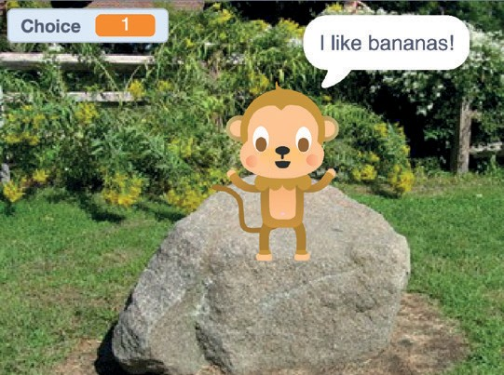
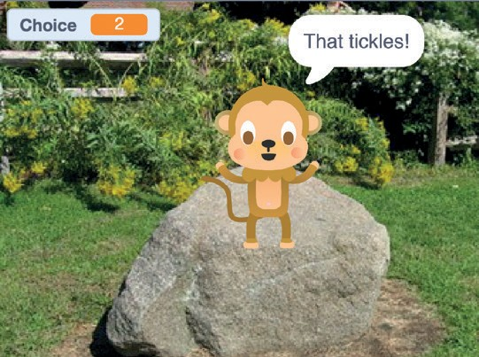
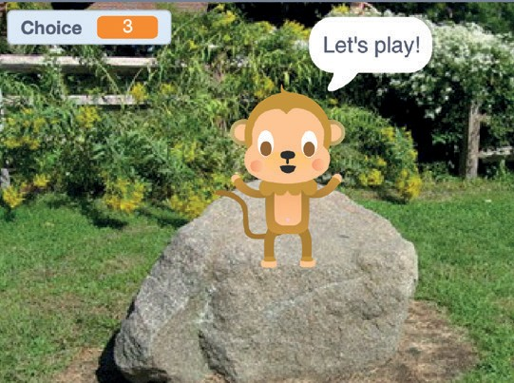
What Will Your Pet Say?
Let your pet choose what it will say.
Virtual Pet
5

Slide 12
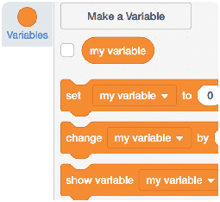
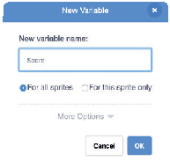
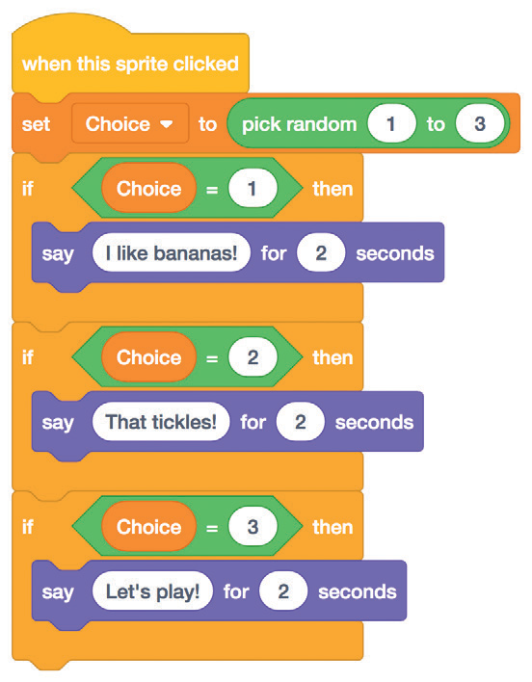

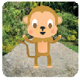
What Will Your Pet Say?
scratch.mit.edu
GET READY
Choose Variables.
Click the Make a Variable button.
Choice
Name this variable Choice
and then click OK.
ADD THIS CODE
Insert the pick random block.
Monkey
Insert the Choice block into the equals block from the Operators category.
Type things for your pet to say.
TRY IT
Click your pet to see what it says.

Slide 13

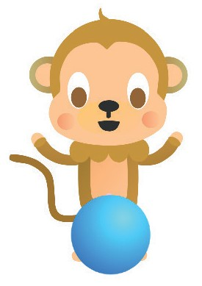

Time to Play
Have your pet play with a ball.
Virtual Pet
6

Slide 14


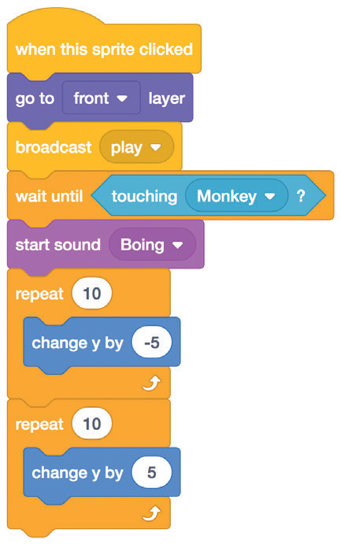
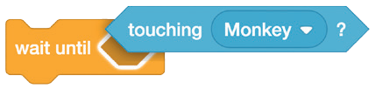
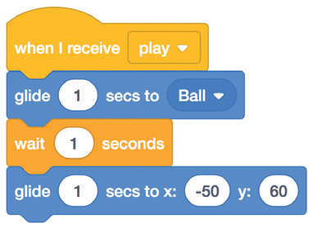


Time to Play
scratch.mit.edu
GET READY
Choose a sprite, like Ball.
Ball
ADD THIS CODE
Ball
Broadcast a new message.
Choose Monkey from the menu.
Type a minus sign to make the ball move down.
Insert the touching block into the wait until block.
A positive number makes the ball move up.
Choose play from the menu.
Pick Ball from the menu.
Monkey
TRY IT
Click the ball.

Slide 15
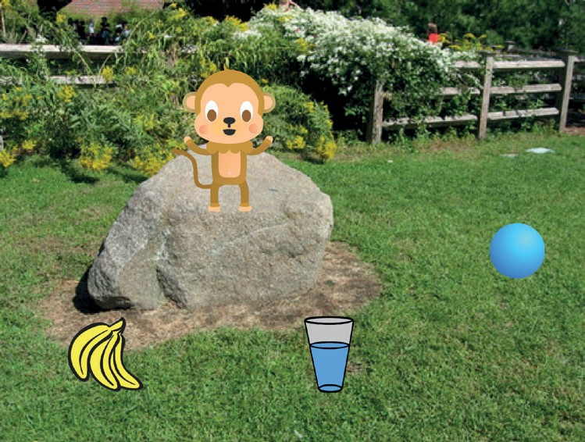
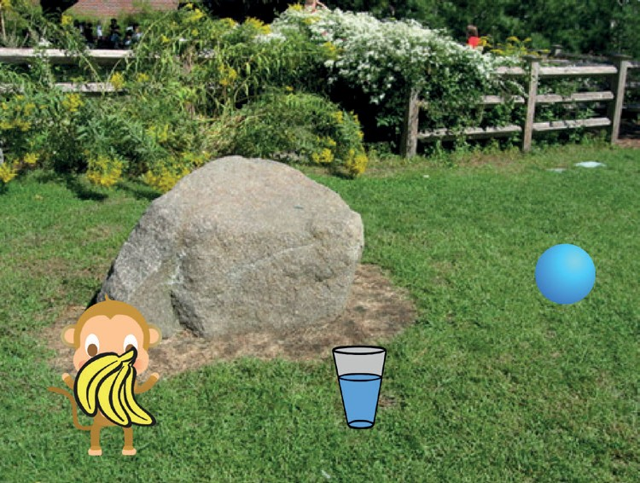
How Hungry?
Keep track of how hungry your pet is.
Virtual Pet
7

Slide 16

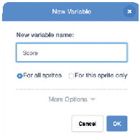
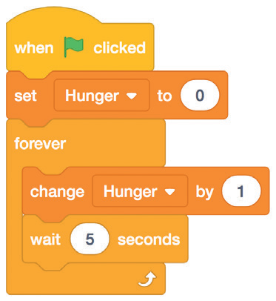
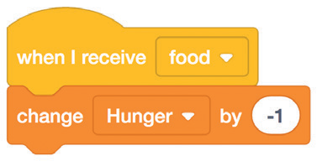


How Hungry?
scratch.mit.edu
GET READY
Choose Variables.
Click the Make a Variable button.
Hunger
Name this variable Hunger
and then click OK.
ADD THIS CODE
Monkey
Choose food from the menu.
Reset hunger level.
Increase hunger level every 5 seconds.
Type a minus sign to make your pet less hungry when it gets food.
TRY IT
Click the green flag to start.
Then click the food.

